Slide 1
Predicting Next Day Stock Price by using Supervised Machine Learning Models on Technical Indicators
Man Yi (Ariel) Yeung
CS 613
12/10/2020

Slide 2
Problem Statement
The goal of the project is to predict next day stock price (open, close, high, and low prices) from using supervised machine learning models on 27 technical indicators of the past 5 days.
The data is sourced from Alpha Vantage API.
The stocks investigated are IBM, AAPL (Apple), and JNJ (Johnson and Johnson).
The indicators consists of the volume of trade, dividend, simple moving average (SMA), exponential moving average (EMA), moving average convergence/divergence (MACD), stochastic oscillator (STOCH), relative strength index (RSI), average directional movement index (ADX), commodity channel index (CCI), Aroon indicator (AROON), Bollinger bands (BBANDS), Chaikin A/D line (AD), and on balance volume (OBV).

Slide 3
Related Work
Many past research has been conducted in this area. Some models used include artificial neural networks (ANN) [1], support vector machine (SVM) [2], and so on.
An interesting and fairly recent term called “Stock2Vec” describes many algorithm to predict stock price. It is used in sentiment analysis on financial news for stock predict [3], as well as a deep learning approach using “Stock2Vec” as input features and applying convolutional network to predict daily stock price [4].

Slide 4
Related Work
This project’s approach is similar to two particular studies:
The first study views the price prediction as a classification problem of whether price moves up, down or stays stationary. It applies logistic regression on qualitative and quantitative features related to the particular stock [5]
The second uses artificial neural network (ANN), support vector machine (SVM), random forest and naive-Bayes on technical parameters calculated using stock open, high, low and close price, in order to predict stock price in the Indian market [6].

Slide 5
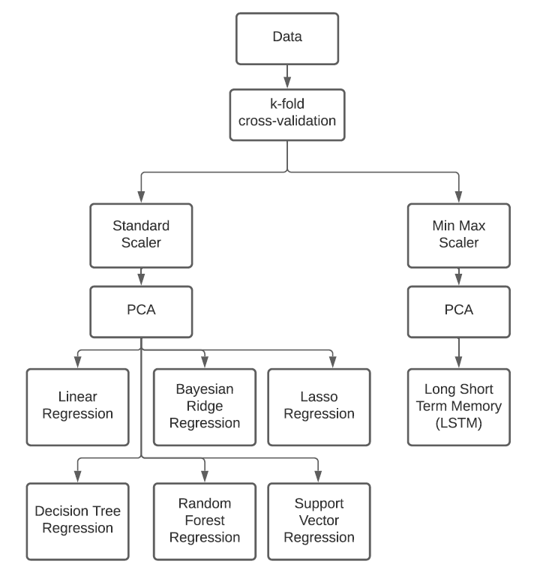
Methodology

Slide 6
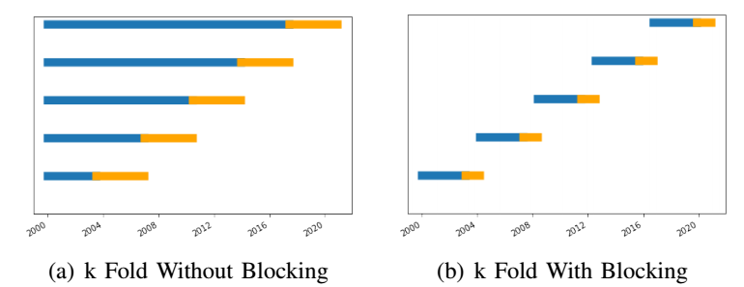
Experiments – k-fold
Time series k-fold split with and without blocking can be visualized in the below figure. A k value of 5 is used for visualization, while a k value of 10 is used in the actual data pre-processing.

Slide 7
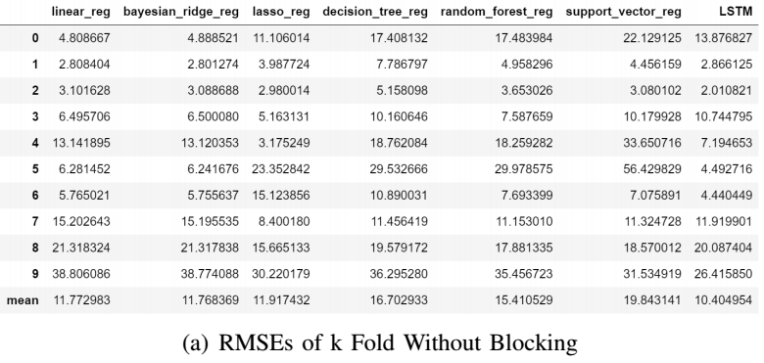
Results – k-fold
k-Fold cross-validation without blocking for IBM stock open price

Slide 8
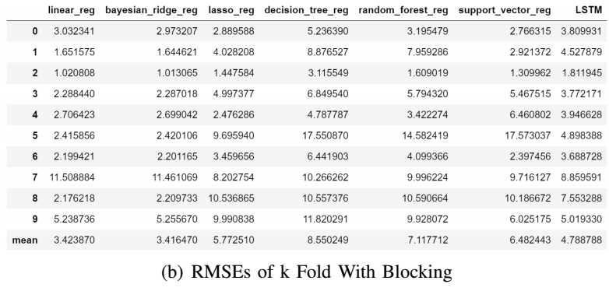
Results – k-fold
k-Fold cross-validation with blocking for IBM stock open price

Slide 9
Results – k-fold
K-fold cross validation with blocking results in average root mean square error (RMSE) values of between 3 and 10 for each model and a maximum RMSE of no more than 18.
For result obtained without blocking k-fold cross validation, the mean RMSE values range between 10 and 20, with a maximum at more than 38.
From this experiment, it can be observed that k-fold cross-validation with blocking will generate a better forecast.
Furthermore, The RMSE values for the different splits from k-fold cross-validation with blocking are quite consistent despite some peaks at k=5 and k=7 values for certain models.

Slide 10
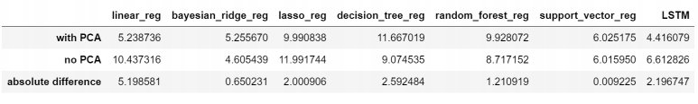
Experiments and Results - PCA
The effects of principle component analysis (PCA) on model prediction's RMSE scores on displayed below.
The figure contains the RMSE values of the last split of the k-fold train-test set for IBM's daily open price prediction.
For most models, PCA perform better, except for Bayesian ridge regression, and decision tree regression.
Notes:
The effects of PCA on model prediction's RMSE scores are shown in Figure \ref{figure:pca_no_pca}. The figure contains the RMSE values of the last split of the k-fold train-test set for IBM's daily open price prediction. For some models, like Bayesian Ridge Regression and Support Vector Regression, there is minimal difference in RMSEs of the predicted results. For other models, the difference is more noticeable, with linear regression having the most different of about 5 in terms of RMSE values. For most models, PCA perform better, except for Bayesian ridge regression, decision tree regression, and support vector regression.

Slide 11
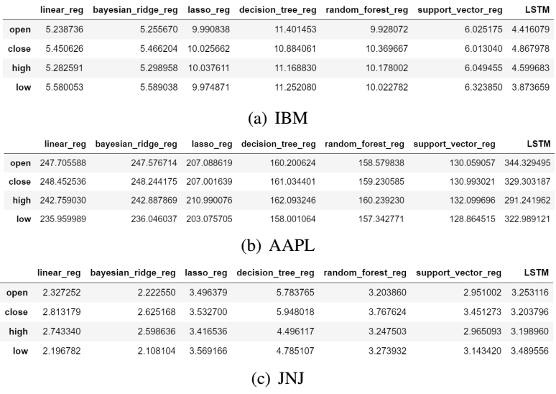
Experiments and Results
The seven regression models are implemented on the open, close, high, and low price data for IBM, AAPL, and JNJ stocks.

Slide 12
Experiments and Results
Differences in model performance for the four different price types are minimal, and for demonstration of model forecast results, only open prices’ actual forecasts of the three stocks will be presented.
For IBM and JNJ stocks, the best models are the long short term memory model, linear regression and Bayesian ridge regression, with RMSE values between 2 and 5.
For AAPL stock, the performance is much worse than the two other stock. Random forest regression and support vector regression works better than other models, but all models have RMSE values of more than 120.
This technical indicator approach fails to provide a reasonable prediction for the AAPL stock. Reasons for unsuccessful prediction for AAPL might be inconsistency in technical indicator data or large fluctuations in stock price that the models do not account for.

Slide 13
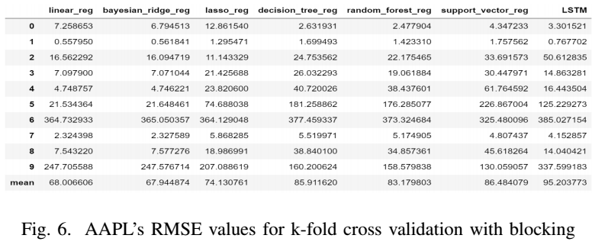
Experiments and Results
The performance of models for each k-fold split for AAPL is investigated
The models work consistently worse than the other two stocks except for the 0th and the 1st split, which indicates that the cause is fluctuations in stock price that are not accounted for in the model, and might not be correlated with past technical indicators.
Notes:
This might be due to inconsistency in technical indicator data or large fluctuations in stock price that the models do not account for. To investigate further, Figure \ref{figure:AAPL_special_rmse} shows the effects for each data split. It can be observed that the models work significantly worse for AAPL than the two other stocks, especially on splits 6 and 9.

Slide 14
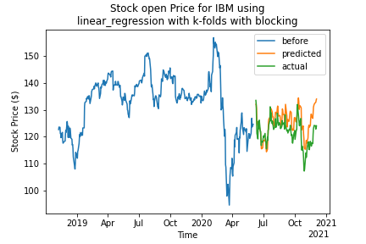
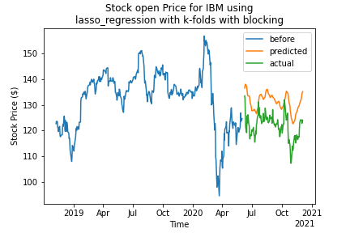
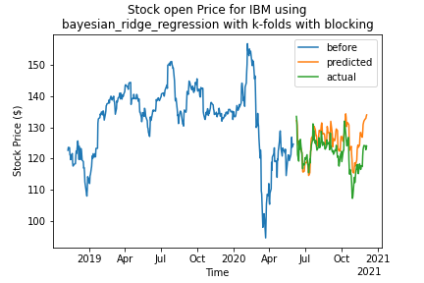
Forecast – Open Price for IBM

Slide 15
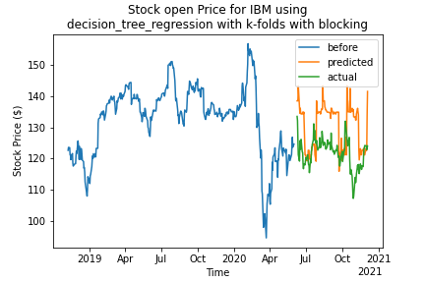
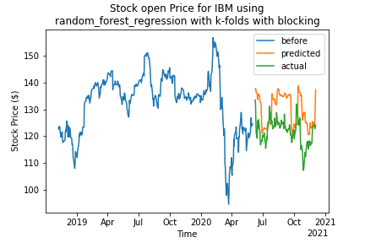
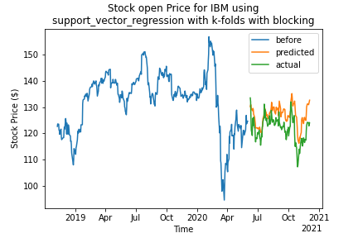
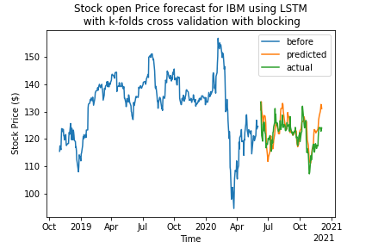
Forecast – Open Price for IBM

Slide 16
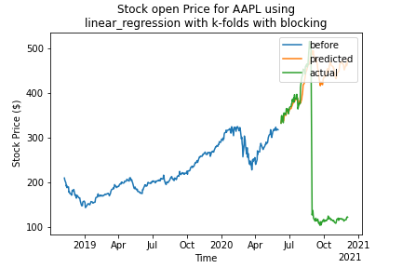
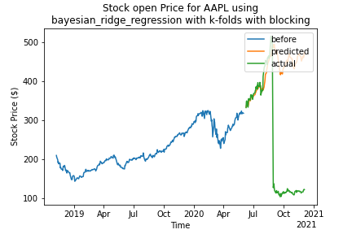
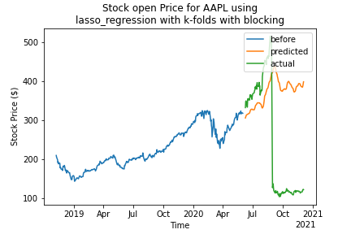
Forecast – Open Price for AAPL

Slide 17
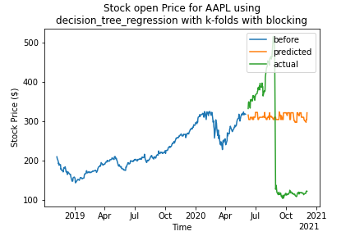
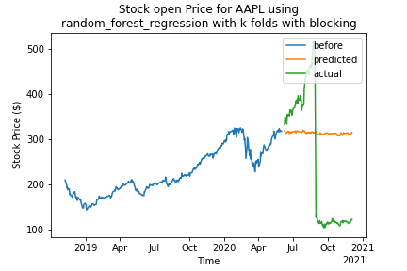
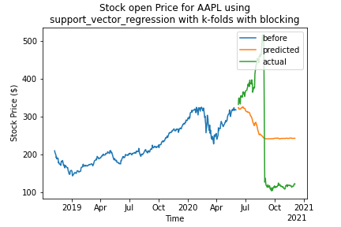
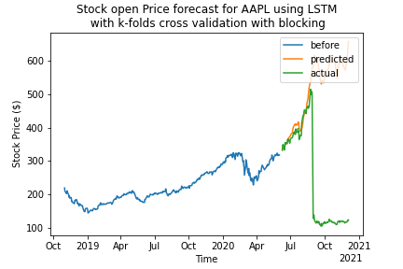
Forecast – Open Price for AAPL

Slide 18
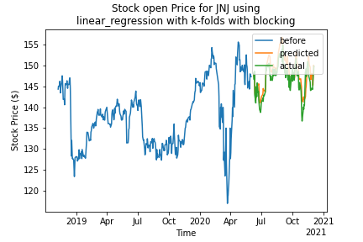
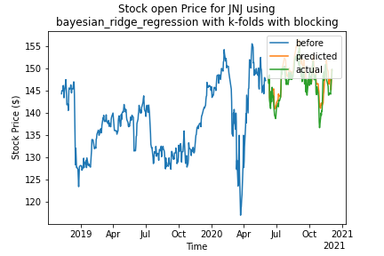
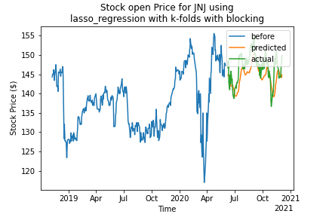
Forecast – Open Price for JNJ

Slide 19
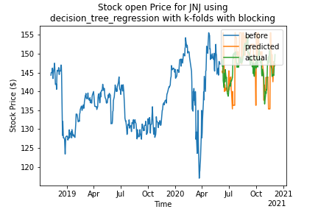
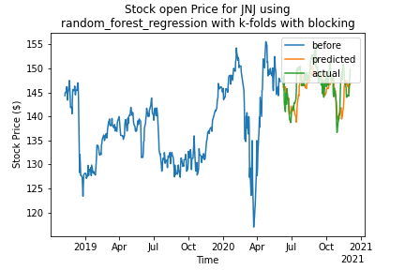
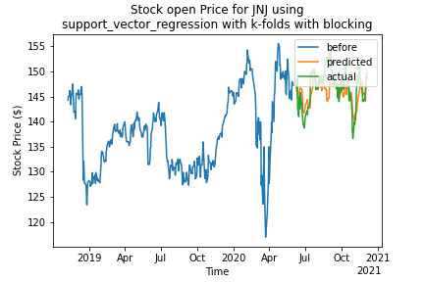
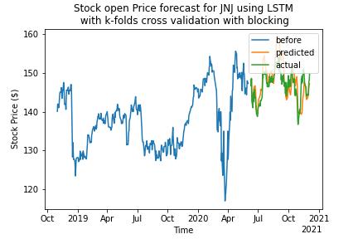
Forecast – Open Price for JNJ

Slide 20
Conclusion
Daily stock price are predicted by applying machine learning models to past 5 days' technical indicators.
Stock price and technical indicator data for the past almost 20 years are used to train the models after pre-processing steps including k-fold cross-validation split with blocking, normalization with standard scaler and min max scaler, as well as principle component analysis for dimensionality reduction.
The best models are long short term memory model, linear regression model and Bayesian ridge regression model for the IBM and JNJ stocks.
For AAPL, this approach of predicting stocks through technical indicators does not provide promising result.
Therefore, this method of stock price prediction through analyzing technical indicators might not be applicable to all stocks, but it shows good prediction results to stocks that have trends more correlated with past technical indicators

Slide 21
Future Works
The independent variable can be adjusted to price difference between next day and current day. This will help to isolate the effect of original stock price.
Another improvement to the project can be to obtain a multi-day forecast instead of just a next-day forecast, by continue predicting on predicted data. However, this will require calculations of technical indicators based on daily open, daily close, daily high, and daily low predicted prices. Since some features depend on volume of trade, it requires some method of estimating the volume of trade.
One additional feature can be added before using this approach is to identify stocks that are likely to be correlated with technical indicators like the IBM and JNJ studied in this case. This will save time and computational power so it is not wasted to obtain unusable results for stocks like AAPL.
Or more factors like company news and fundamental analysis of the stock can be included to make this approach more generalized for all kinds of stocks.

Slide 22
Bibliography
[1] W. Jasic, “The profitability of daily stock market indices trades based on neural network predictions: case study for the S&P 500, the DAX, the TOPIX and the FTSE in the period 1965-1999,” Applied financial economics, vol. 14, no. 4, pp. 285–297, Feb. 2004, doi: 10.1080/0960310042000201228.
[2] C. Yu, “Evolving Least Squares Support Vector Machines for Stock Market Trend Mining,” IEEE transactions on evolutionary computation, vol. 13, no. 1, pp. 87–102, Feb. 2009, doi: 10.1109/TEVC.2008.928176.
[3] D. L. Minh, A. Sadeghi-Niaraki, H. D. Huy, K. Min, H. Moon, Deep learning approach for short-term stock trends prediction based on two-stream gated recurrent unit network, Ieee Access 6 (2018) 55392–55404 (2018).
[4] W. Wang, “Stock2Vec: A Hybrid Deep Learning Framework for Stock Market Prediction with Representation Learning and Temporal Convolutional Network,” Sep. 2020.
[5] K. Ntakaris, “Mid-price prediction based on machine learning methods with technical and quantitative indicators,” PloS one, vol. 15, no. 6, pp. e0234107–e0234107, Jun. 2020, doi: 10.1371/journal.pone.0234107.
[6] J. Patel, S. Shah, P. Thakkar, and K. Kotecha, “Predicting stock and stock price index movement using Trend Deterministic Data Preparation and machine learning techniques,” Expert Systems with Applications, vol. 42, no. 1, pp. 259–268, 2015.

Slide 23
The End
Thank you!

